Slide 1
Git at the PI
Computing at the PI
HTCondor and the D0 cluster
Blake Leverington, with notes from Alexey Zhelezov

Slide 2
The PI Git Repository
Login with your PI credentials.
Not everyone has, or will maintain CERN credentials
Not everyone is an LHCb member
Thesis repository and archive: https://git.physi.uni-heidelberg.de/lhcb_theses
  Not publicly accessible. Only internal.
  Archive your thesis pdf and relevant project work here, for future use by the group.
  Please upload the figures in a folder, and/or figure data and macros to make them (.C).
  If you keep some files private (i.e. not archived here), that's fine.
  How many bachelor, masters and phd projects have disappeared?
https://git.physi.uni-heidelberg.de/HIT-PAT
https://git.physi.uni-heidelberg.de/HE-LHCb
Etc..

Slide 3
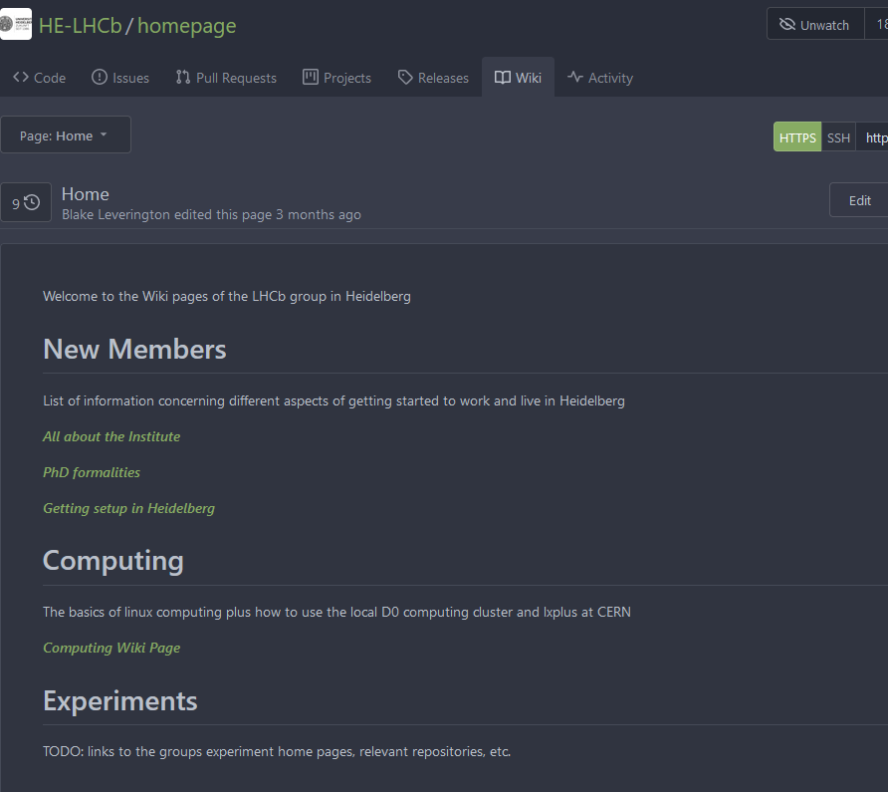
The PI Wiki
https://git.physi.uni-heidelberg.de/HE-LHCB/homepage/wiki
Easy to edit and create useful pages of information
Computing How-to’s,
new joiner information
Best when used and maintained by everyone
  Contribute your knowledge
  What did you wish you knew when you started?

Slide 4
The computing page:
https://git.physi.uni-heidelberg.de/HE-LHCb/homepage/wiki/computing
Some links with useful computing information for beginners in HEP
  HEP Essentials: Linux, bash scripting, python, jupyter, git, etc.
  LHCb Starter kits
  A lot of the LHCb Software Twiki pages are old and outdated.
How to use the local computing cluster “D0”
Building the LHCb Software stack
Please add more…
  Like Git how-to’s, etc

Slide 5
Available systems
  4 Interactive nodes with Ubuntu environment:
    Lhcba2: Dual AMD EPYC 7713 64-Core Processors ( 256 CPU threads), 3.7 GHz, 1 TB RAM
    Lhcba1: Dual AMD EPYC 7352 24-Core Processors ( 96 CPU threads), 3.2 GHz, 264 GB RAM
    d0new: Dual AMD Opteron(tm) 6344 6-core Processor (24 CPU threads), 2.6 GHz, 132 GB RAM
    delta, Dual Quad-Core AMD Opteron(tm) Processor 2360 SE (8 CPU threads), 2.5 GHz, 16 GB RAM
    Lhcbi1 (special purpose): Dual socket Intel(R) Xeon(R) Silver 4214 CPU (48 CPU threads), 2.20GHz , 96 GB RAM –
      Don’t use unless you know you need to use this specific machine
  singularity support under Ubuntu (lhcba2, lhcba1, d0new, delta, batch system)
  batch system (190 slots HTCondor)
$ ssh -X -p32 leverington@lhcba2.physi.uni-heidelberg.de
Ports:
24 - host Ubuntu
30 - CentOS7
32 – ALMA Linux 9 (RHEL9)

Slide 6
Storage
  /scratch on some local machines (eg. build stacks here)
  /work
    Mounted on sigma0 (network connected via NFS)
    Relatively high performance 22 TB.
    daily backups. Please do not use this space for data sets greater then O(100 GB).
  /auto/data
    Mounted on d0new (network connected via GlusterFS)
    Slow distributed 260TB storage for big files.
    No backups.
  /home
    Mounted on rho0 (network connected) via NFS
    Do not use for anything more than documents.
    Hosts your e-mail folder, etc.
    Backed up
$ mkdir –p /work/<yourusername> #make your own work directory if it doesn’t exist

Slide 7
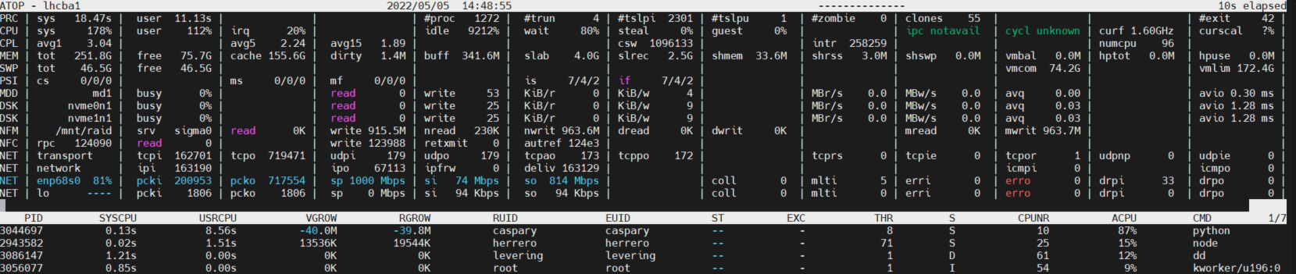
Play nice.
Pay attention to resource consumption! Use atop (only Ubuntu –p24) and/or top
1000 Mbps network connection → read/write data is the first bottleneck seen usually
No network capacity left means no good connection for your colleagues

Slide 8
Disk Space
There are 30-40 people using the resources and only 22 TB on /work
Easy to fill these days with 500 GB of data sets per person
(this seems to be our bottle-kneck most times)
$ du -h --summarize /work/clangenb/ #check the size of your directory
$ /home/bleverin/software/gdu_linux_amd64 -m 8 /work #check the size of all directories

Slide 9
Compression
Fast and efficient lossless compression with zstd:
$ zstd -8 –T8 –rm –r --output-dir-mirror -o /work/compressedfolder/*.zst /work/sourcefolder/*.mdf
.root files already have some significant compression.
https://root.cern/manual/io/#compression-and-performance
ROOT offers several options, such as LZMA with very high compression ratio, or LZ4 with very high decompression throughput, or ZSTD with a good compromise in performance. The default compression for RNTuple is ZSTD level 5; for everything else it’s zlib with compression level 1. Algorithm and compression level can be selected using TFile::SetCompressionAlgorithm() and TFile::SetCompressionLevel(), respectively, at the time data is written.

Slide 10
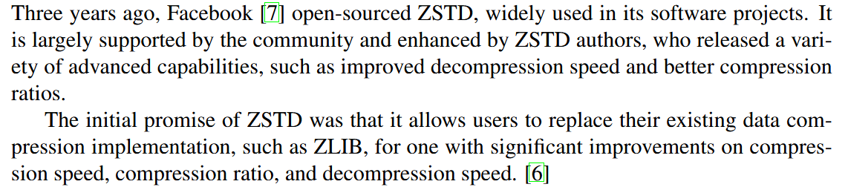
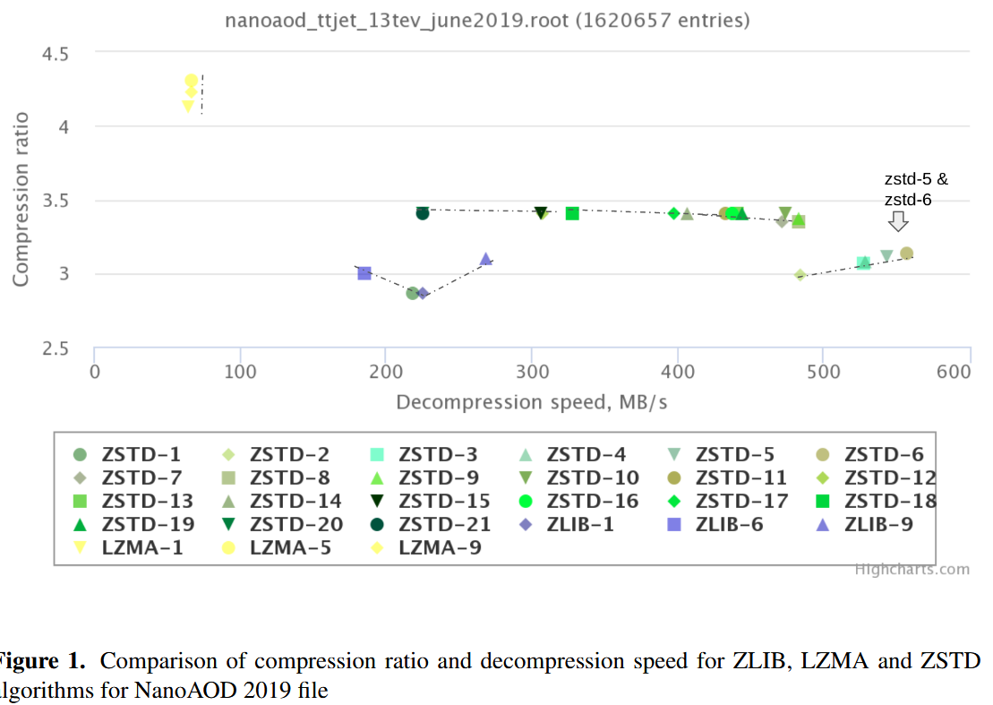
Compression
(2017)
The ratio here is for a particular standard file.
In LHCb, global .mdf can compress by 5 times! SciFi NZS by 20 times.
https://www.epj-conferences.org/articles/epjconf/pdf/2020/21/epjconf_chep2020_02017.pdf

Slide 11
Best Practices at the PI (to be discussed)
use lhcba2 as your interactive login machine.
Compile your development code and store histogram files and results on /work. Consider using /scratch to build standard stacks, lbconda, etc.
  /work for things that need to be backed up. Weeks of work lost if something happens.
Put large data sets on /auto/data
  things that can be downloaded from elsewhere or rerun in a couple days
Try not to stream data from cern and run multi-core process on lhcba1/2 for extended periods (>2 minutes)
  Fine for 1 person, doesn’t scale beyond a couple of people on our system.
  Consider using the/a batch system and /auto/data, keep results on /work, if you are running data/computationally intensive process.
  Can also be run interactively on the batch system
Full LHCb analyses should be sent to the GRID via Ganga (lhcba1/2 or lxplus)
If in doubt, ask Alexey how to best run your data.

Slide 12
Environment Setup
#See what is already defined in your environment:
leverington@lhcba2:/work/leverington/lhcb
$ env
#Basic environment which will give you access to the python-based lb-XXXX env-tools:
leverington@lhcba2:/work/leverington/lhcb
$ /cvmfs/lhcb.cern.ch/lib/LbEnv
#Check which platforms are available on the server you logged in to:
leverington@lhcba2:/work/leverington/lhcb
$ lb-describe-platform
#set the environment to point to an LCG software stack
leverington@lhcba2:/work/leverington/lhcb
$ source /cvmfs/sft.cern.ch/lcg/views/LCG_105a/x86_64-el9-gcc12-opt/setup.sh

Slide 13
CVMFS
CernVM File System (CernVM-FS)
  global delivery of scientific software, containers, and auxiliary data
  read-only filesystem for those who access it
  designed to be scalable and reliable, with known deployments involving hundreds of millions of files and many tens of thousands of clients.
  https://cvmfs-contrib.github.io/cvmfs-tutorial-2021/01_introduction/
Exactly the same software version and compiled the same way at CERN and here at the PI

Slide 14
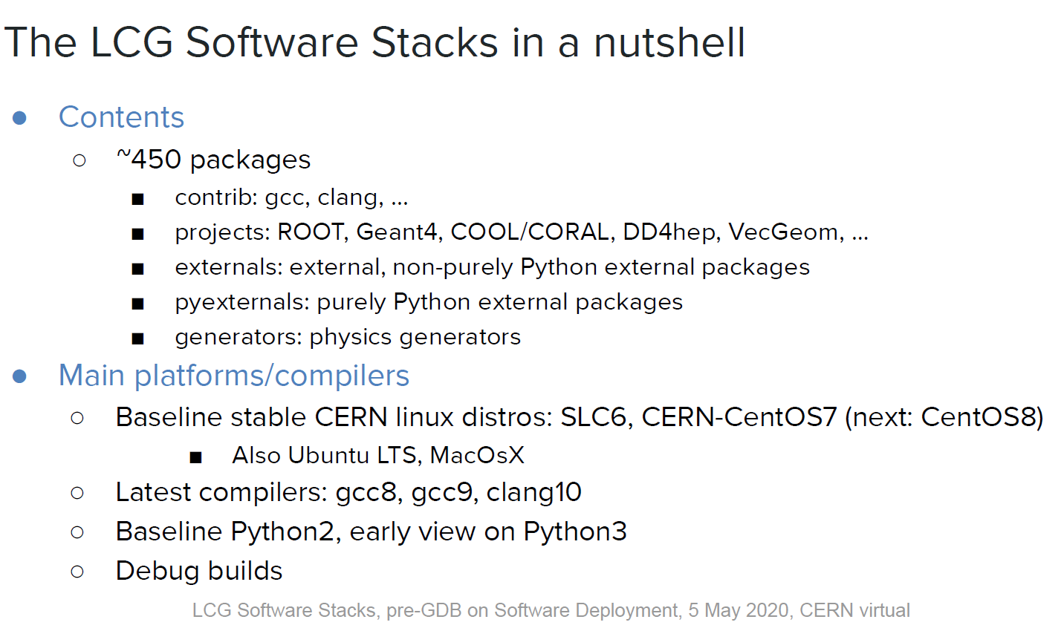
LCG Software Stack in CVMFS
, RHEL9 (Alma Linux 9)
, gcc11, gcc12, gcc13, etc
Python3

Slide 15
leverington@lhcba1:/work/leverington/lhcb
$ source /cvmfs/sft.cern.ch/lcg/views/LCG_101/x86_64-centos7-gcc8-opt/setup.sh
leverington@lhcba1:/work/leverington/lhcb
$ which python
/cvmfs/sft.cern.ch/lcg/views/LCG_101/x86_64-centos7-gcc8-opt/bin/python
leverington@lhcba1:/work/leverington/lhcb
$ python --version
Python 3.9.6
leverington@lhcba1:/work/leverington/lhcb
$ gcc –v
gcc version 8.3.0 (GCC)
leverington@lhcba1:/work/leverington/lhcb
$ which root
$ which root
alias root='root -l'
/cvmfs/sft.cern.ch/lcg/views/LCG_101/x86_64-centos7-gcc8-opt/bin/root
leverington@lhcba1:/work/leverington/lhcb
$ root --version
ROOT Version: 6.24/06
Personal experience: not all LCG versions will work with your code. Depends on compilation options a lot.
LCG_105a seems to be bug free and works with current LHCb software stack.

Slide 16
HTCondor and Batch Jobs

Slide 17



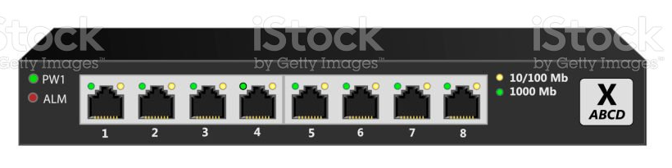



Disk and Network usage
Our current user
lhcb-raid01
lhcb-raid02
lhcb-raid03
1 Gigabit
lhcba1
lambdac
+ ….
/work
sigma0
/auto/data
d0new

Slide 18








Disk and Network usage
Growing number of users
lhcb-raid01
lhcb-raid02
lhcb-raid03
lhcba1
lambdac
+ ….
/work
sigma0
/auto/data
d0new

Slide 19
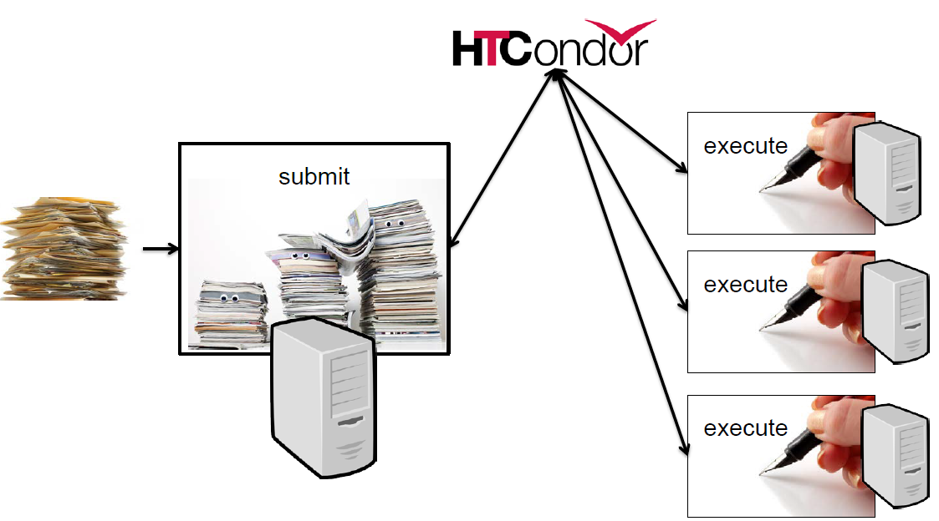
Batch submission via HTCondor
Split a computational job into multiple jobs to make use of computing resources and your time.
The job (program) must be executable from the command line (not interactive).
  You can specify input files, and output files, and pass arguments.
  We used a shared filesystem in Heidelberg (no need to transfer)
Will run in a “sandbox”. Doesn’t know your environment variables unless you pass them or set them up explicitly.

Slide 20
Use case example:
  1000 events LHCb detector simulation (Gauss) takes ~150 hours on 1 CPU.
    split it into 20 different 50 event jobs and run on 20 CPUs (each finishes in 8 hours)
    I can specify when each job is to start (spread them out in time, or run at night to be nice.)
  Many configurable options. https://htcondor.readthedocs.io/en/latest/users-manual/

Slide 21


Disk and Network usage
lhcb-raid01
lhcb-raid02
lhcb-raid03
1 Gigabit
lhcba1
lambdac
+ ….
/work
sigma0
/auto/data
d0new

Slide 22
Preparing a job submission
Two files to be prepared:
1. The submission file: (.sub)
  Contains all the parameters that HTCondor needs to run your executable on the available slots of the computing pool
2. The executable: typically a bash script
  Sets up your environment, folder structure
  (maybe) takes the arguments passed from the submission file to execute the program in a different way
    i.e. random number seed, input files, etc.

Slide 23
The job submission file:
$ condor_submit examplejob.sub
#examplejob.sub
# Generic job which will run under local CentOS7 container, on modern servers only What to run and arguments, can (and probably always should be) a script
executable = ./job.sh
arguments = $(ClusterId) $(ProcId)
# $(ClusterId) is the number assigned to the group of sub-jobs
# $(ProcId) is the number assigned to each sub-job
# Safe option, so files are not transfer when not required (our servers have access # to the same storage, /auto/work, /auto/data, /home).
should_transfer_files = IF_NEEDED
# Without variable part, output files will be the same for all jobs. # That can be confusing.
output = output/$(ClusterId)/job.$(ProcId).out
error = output/$(ClusterId)/job.$(ProcId).err
log = output/$(ClusterId)/job.log
# It is possible apply current environment variables in jobs, with the following # flag. But in general when particular environment is required, safe option # is directly call the script which setup correct environment (lb-run, etc). In LHCb case # that can also set optimal platform.
#getenv = True
# The following flag by itself set 2 following options. It is set by default # when submiting from CentOS7 container, but setting it explicitly produce
# desired result from Ubuntu as well (when submited from hosts supporting it).
+FromVIRTC = "CentOS7“
# the number of jobs
queue 10
https://htcondor.readthedocs.io/en/latest/users-manual/submitting-a-job.html

Slide 24
The executable:
Typically a bash script, but not necessarily. Should be executable on its own.
https://git.physi.uni-heidelberg.de/HE-LHCb/homepage/wiki/computing_shell_scripts
#!/bin/bash
#examplejob.sh
#setup the job folders
HOMEFOLDER=/work/leverington/lhcb/examplejob
#\$1 is the first argument passed to a bash script (job ClusterID in this case)
mkdir -p $HOMEFOLDER/output/${1}/${2}
cd $HOMEFOLDER/output/${1}/${2}
#setup a simple LCG environment
#source /cvmfs/sft.cern.ch/lcg/views/LCG_101/x86_64-centos7-gcc8-opt/setup.sh
#delay each executable so that they do not all start and stop at the same instant. Be nice to the network.
sleeptime=$(echo "$2 * 30" | bc)
sleep $sleeptime
#our executable that we really wanted to perform (something simple to try, write a 1 GB file). Use full paths.
dd if=/dev/zero of=test.file bs=64M count=16 oflag=dsync

Slide 25
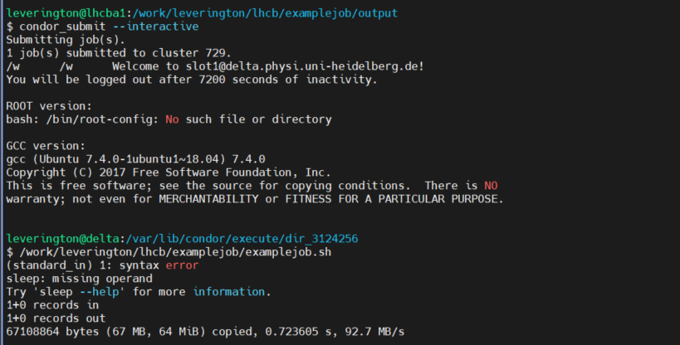
Run htcondor in interactive mode
Run your executable from a condor node. Check for errors.

Slide 26
Run and Monitor your jobs
leverington@lhcba1:/work/leverington/lhcb/examplejob
$ condor_submit example.sub
Submitting job(s)..........
10 job(s) submitted to cluster 724.
leverington@lhcba1:/work/leverington/lhcb/examplejob
$ condor_q
-- Schedd: lhcba1 : <147.142.19.151:9618?... @ 05/05/22 16:59:59
OWNER BATCH_NAME SUBMITTED DONE RUN IDLE TOTAL JOB_IDS
leverington ID: 724 5/5 16:59 _ 10 _ 10 724.0-9
Total for query: 10 jobs; 0 completed, 0 removed, 0 idle, 10 running, 0 held, 0 suspended
Total for leverington: 10 jobs; 0 completed, 0 removed, 0 idle, 10 running, 0 held, 0 suspended
Total for all users: 13 jobs; 0 completed, 0 removed, 3 idle, 10 running, 0 held, 0 suspended
leverington@lhcba1:/work/leverington/lhcb/examplejob
$ condor_wait -status output/job.724.log

Slide 27
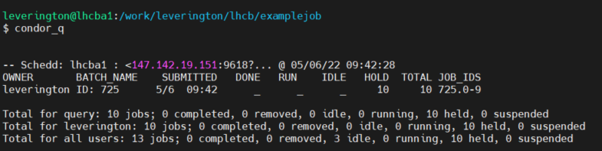
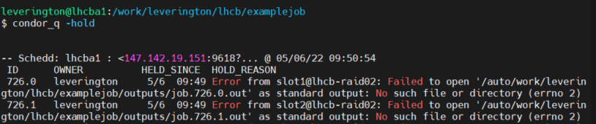

Common errors
Cause: my error, stdout/stderr output and logfiles were to be written to a folder that doesn’t exist
Check that one or two small jobs run before submitting anything large and time consuming.

Slide 28
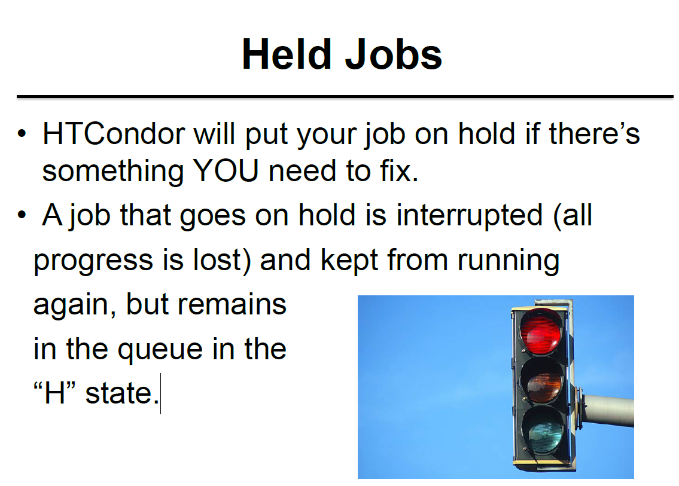
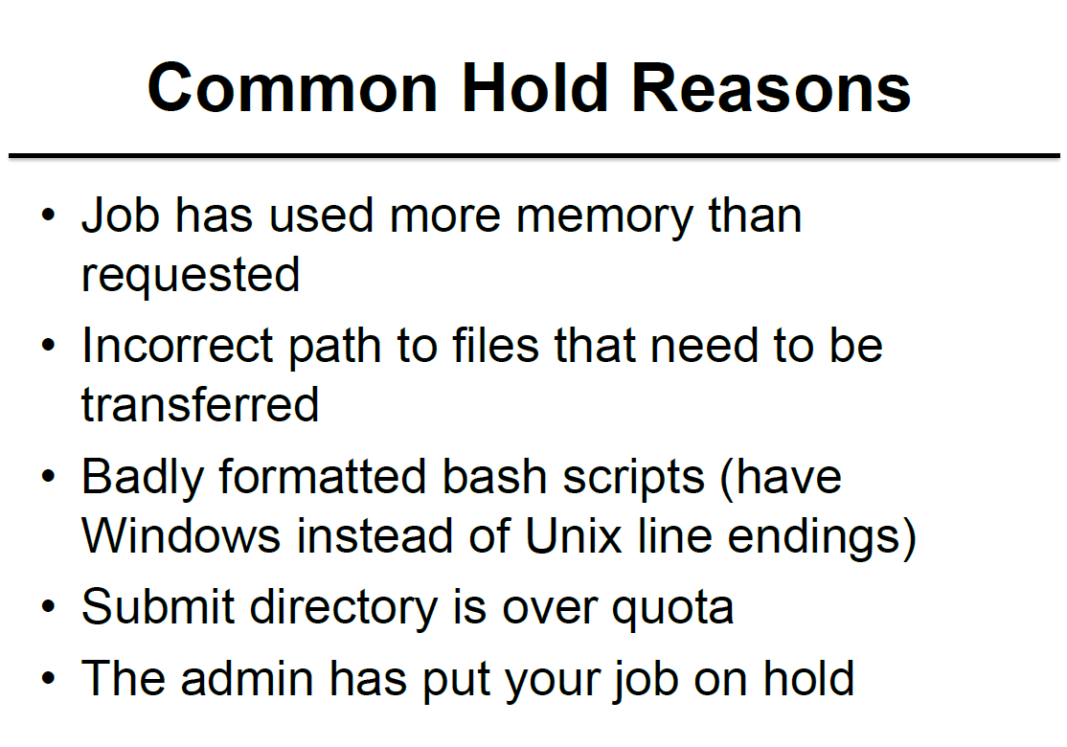

Job attributes can be edited while jobs are in the queue using:
condor_qedit [U/C/J] Attribute Value
If a job has been fixed and can run again, release it with:
condor_release [U/C/J]

Slide 29
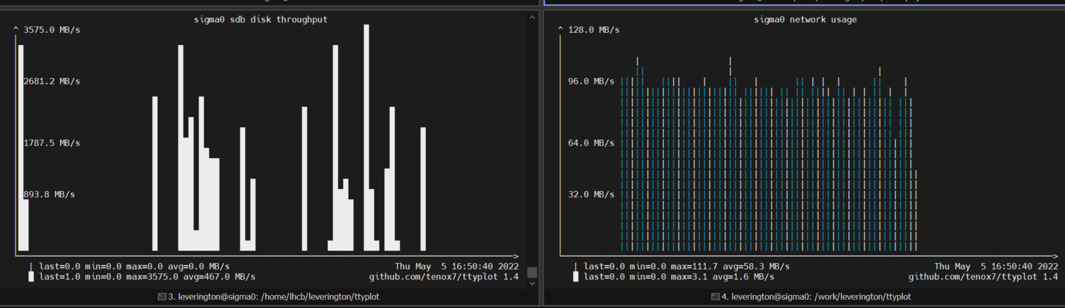
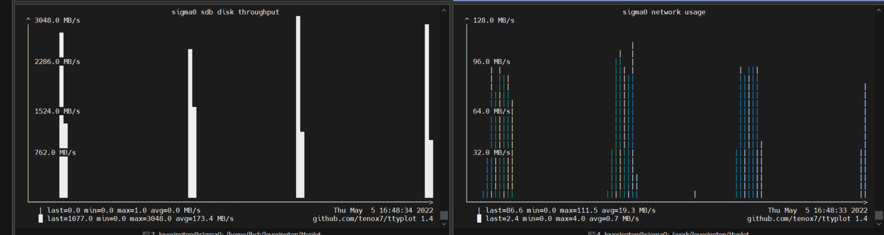
A series of jobs all started and finished at once.
Disk and Network usage.
Lhcba1 network
/work Disk usage
/work Network usage
100%
sigma0 network
…spaced out by 30 seconds
/work Disk usage
/work Network usage

Slide 30
Summary
The resources are there to be used, so use them.
  But be aware of what you are using and be nice.
  Share them or make a plan for the best time.
Mattermost channel: sign up with PI email or CERN email.
  Probably ask any questions here first.
  https://mattermost.web.cern.ch/heidelberglhcb/channels/lhcbi1-comrades
Alexey Zhelezov is the person to contact when you have problems or requests.
  He is maintaining the servers.
Network and disk monitoring from the terminal (previous plots)
https://github.com/tenox7/ttyplot

Slide 31
Backup

Slide 32
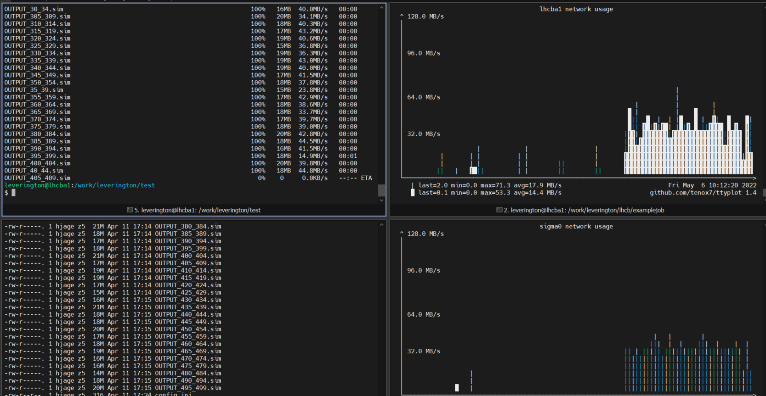
Disk and Network usage
scp many files from CERN (~40 MBytes/s)

Slide 33
